Slide 1
Pre-match Preparation
Presented by
South Central Officials Association

Slide 2
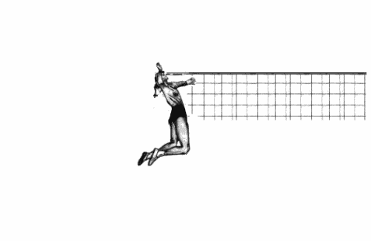
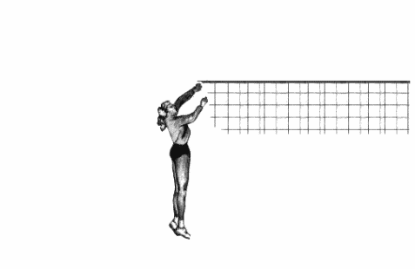
Pre-match Preparation
You have a volleyball match tonight and for those involved it is a big match even if on paper it may not appear to be.
You need to approach it as if it were the match your entire season was going to be judged by and your pay depended on you doing a great job.

Slide 3
Your court-side responsibilities start no later than about 30 minutes prior to the match start time. So you should arrive at the match site 45-60 minutes prior to match start time.

Slide 4
It would be nice if the host site would provide a room where the officials can meet and prepare for the match and leave their “stuff” in a secured area. This would also be the place where the officiating crew (all who would like to be involved) could debrief after the match to go over any problems that might have arisen during the match. This debrief makes every match a learning experience for all the officials

Slide 5
What you might do is at the beginning of the week when you contact the school to confirm you are planning on officiating a match for them is to communicate something like, “I am scheduled to officiate a match at your school on Tuesday of this week with a 7:00 start time. It would be very nice if the officials could have a room in which to meet so that we could discuss our plans for the match, leave our valuables and meet afterwards to de-brief what happened during the match”

Slide 6
You should both, R1 & R2 be court side with about 35-40 minutes left on the warm up clock. Take a quick walk around the court to see if there are any unusual structures that require special consideration with respect to ground rules (overhead structures that hang low over a playing area, flags or banners that hang down or space for wheel chairs that is in a playable area.)

Slide 7
An important thing to get out of the way quickly is to find out who will be your event manager for the match and where during the match they will be located in case something arises that you need for them to handle, a serious injury or a disruptive fan for example. These are things that you as the referees need to be aware of but you should never attempt to handle them yourself. Bring them to event management’s attention for them to resolve. In many cases this person might very well be the host school’s head coach.

Slide 8
One official (usually designated to be R1) needs to check the net height. Be careful if the teams are on the court warming up at the time as you might want to have the other official stand guard. Be sure to do this while the team warm ups are limited to their own side of the net and they are not hitting balls across the net
R1

Slide 9
One official (usually designated to be R2) needs to check the game balls for proper pressure and to insure that all game balls are alike.
R2

Slide 10
Sometime between 30 and 25 minutes left on the warm up clock R1 should summon the captains and coaches to a meeting near the table at the division line between the two teams courts by blowing their whistle and holding up the flipping coin.

Slide 11
Sometime between 30 and 25 minutes left on the warm up clock R1 should summon the captains and coaches to a meeting near the table at the division line between the two teams courts by blowing their whistle and holding up the flipping coin.
Have the players and coaches introduce themselves.

Slide 12
Sometime between 30 and 25 minutes left on the warm up clock R1 should summon the captains and coaches to a meeting near the table at the division line between the two teams courts by blowing their whistle and holding up the flipping coin.
Have the players and coaches introduce themselves.
Introduce yourselves as the officials.

Slide 13
Sometime between 30 and 25 minutes left on the warm up clock R1 should summon the captains and coaches to a meeting near the table at the division line between the two teams courts by blowing their whistle and holding up the flipping coin.
Have the players and coaches introduce themselves.
Introduce yourselves as the officials.
Explain any special ground rules to both teams.

Slide 14
Sometime between 30 and 25 minutes left on the warm up clock R1 should summon the captains and coaches to a meeting near the table at the division line between the two teams courts by blowing their whistle and holding up the flipping coin.
Have the players and coaches introduce themselves.
Introduce yourselves as the officials.
Explain any special ground rules to both teams.
Relay any information concerning special events that are to occur at this match (senior night etc.)

Slide 15
Sometime between 30 and 25 minutes left on the warm up clock R1 should summon the captains and coaches to a meeting near the table at the division line between the two teams courts by blowing their whistle and holding up the flipping coin.
Have the players and coaches introduce themselves.
Introduce yourselves as the officials.
Explain any special ground rules to both teams.
Relay any information concerning special events that are to occur at this match (senior night etc.)
Explain the format for the match (2 out of 3, or 3 out of 5)

Slide 16
Sometime between 30 and 25 minutes left on the warm up clock R1 should summon the captains and coaches to a meeting near the table at the division line between the two teams courts by blowing their whistle and holding up the flipping coin.
Have the players and coaches introduce themselves.
Introduce yourselves as the officials.
Explain any special ground rules to both teams.
Relay any information concerning special events that are to occur at this match (senior night etc.)
Explain the format for the match (2 out of 3, or 3 out of 5)
Confirm that the teams are properly attired.

Slide 17
Sometime between 30 and 25 minutes left on the warm up clock R1 should summon the captains and coaches to a meeting near the table at the division line between the two teams courts by blowing their whistle and holding up the flipping coin.
Have the players and coaches introduce themselves.
Introduce yourselves as the officials.
Explain any special ground rules to both teams.
Relay any information concerning special events that are to occur at this match (senior night etc.)
Explain the format for the match (2 out of 3, or 3 out of 5)
Confirm that the teams are properly attired.
Conduct the coin flip to determine who is to serve. Be sure to explain all the options the coin flip winner has. When you flip the coin you should catch it and not turn it over.

Slide 18
Sometime between 30 and 25 minutes left on the warm up clock R1 should summon the captains and coaches to a meeting near the table at the division line between the two teams courts by blowing their whistle and holding up the flipping coin.
Have the players and coaches introduce themselves.
Introduce yourselves as the officials.
Explain any special ground rules to both teams.
Relay any information concerning special events that are to occur at this match (senior night etc.)
Explain the format for the match (2 out of 3, or 3 out of 5)
Confirm that the teams are properly attired.
Conduct the coin flip to determine who is to serve. Be sure to explain all the options the coin flip winner has. When you flip the coin you should catch it and not turn it over.
Collect each teams roster from the coaches.

Slide 19
Now each official has specific duties.

Slide 20
You need to have a discussion with your line judges.
Don’t assume they know exactly what you want them to do. Depending on their experience level you may need to explain where to stand, what to look for and how to signal any violations. Where do you want them to go during a time out and between sets. If they are experienced, let them know how they can help you avoid situations that have been a problem in the past. Explain that they are a vital part of the officiating team and need to stay in the match at all times even if you happen to over rule their call.
R1

Slide 21
You need to have a discussion with your scorers.
Ascertain the experience level of the scorer. Hopefully they are not totally untrained. If they are experienced, find out if they would like you to give them the numbers of the subs or just get our of the way so they can see them. Remind the Libero tracker that they are to keep track of subs as well and they should help the scored see that the correct server has served the ball. Tell the scorer what to do if they have a wrong server. Tell the Libero tracker what to do if they identify an improper Libero replacement and what one of those looks like. You should also warn the scorer not to try and work through a possible problem while the match is in progress. They should have you stop the match and resolve the problem before the match continues. Let the clock operator know they are to allow the time out and between set clock to run down to zero unless you tell them otherwise.
R2

Slide 22
From now until the warm up clock expires you need to observe the teams as they warm up. Evaluate the skill level of the players warming up as setters to have an idea if you are going to have difficulty with that setter or not. If the team warms up two setters, you are likely to see the team run a 6-2 offense with back row setters. If they warm up only one setter they will like run a 5-1 offense with the setter in both the front and back row. Be observant of any players that still have jewelry on. This is also the time for the two officials to devise their game plan if they didn’t have time to do so before they arrived court side.
R1 & R2

Slide 23
The actual line ups for each team are due at 2 minutes left on the warm up clock. Again be proactive with helping this to happen. If a coaches line up is not in with 2 minutes and 30 seconds left, go remind the coach that their line up is due.
When you get it, check to see that a captain is designated, all 6 numbers (7 if a Libero is being used) are unique. if a Libero is not listed, confirm with the coach that they do not intend to use a Libero for this set.
These lineups must remain at the scorers table during the set and a line up must be submitted for each set.
R2

Slide 24
R1 & R2
Shake hands

Slide 25
R1 & R2
Shake hands
Take Your Places

Slide 26
R1 & R2
Shake hands
Take Your Places
Start your Engines

Slide 27
R1 & R2
Shake hands
Take Your Places
Start your Engines
We are ready to Rumble

Slide 28
If you have any questions contact; Kent Neitzert neitzert@coldwatervolleyball.com
You may also have noticed that the player in this presentation never missed a single spike. Try to make your calls the same.

